Slide 1
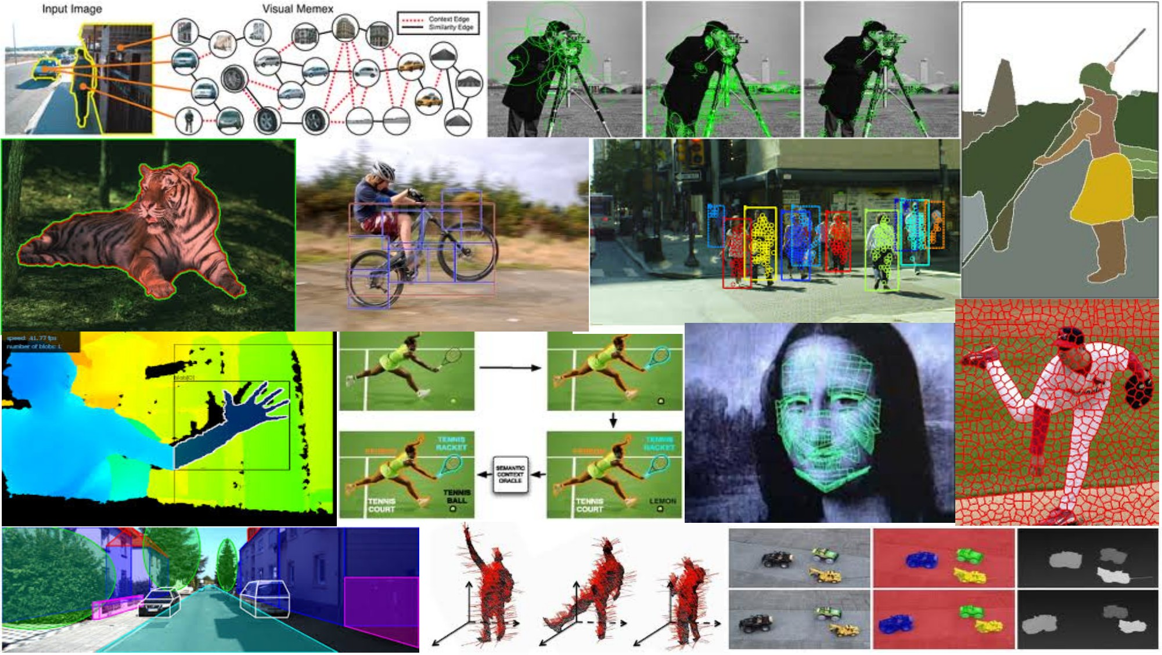
Window-based models for generic object detection May 22th, 2018
Yong Jae Lee
UC Davis

Slide 2
Previously
Intro to generic object recognition
Supervised classification
Main idea
Skin color detection example

Slide 3
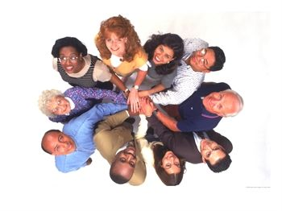
Last time: Example: skin color classification
We can represent a class-conditional density using a histogram (a “non-parametric” distribution)
P(x|skin)
Feature x = Hue
P(x|not skin)
Feature x = Hue
Kristen Grauman

Slide 4
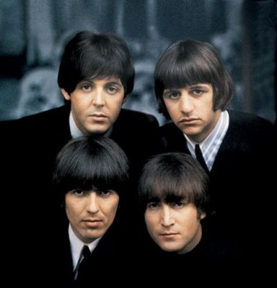
Last time: Example: skin color classification
We can represent a class-conditional density using a histogram (a “non-parametric” distribution)
P(x|skin)
Feature x = Hue
Now we get a new image, and want to label each pixel as skin or non-skin.
P(x|not skin)
Feature x = Hue
Kristen Grauman

Slide 5
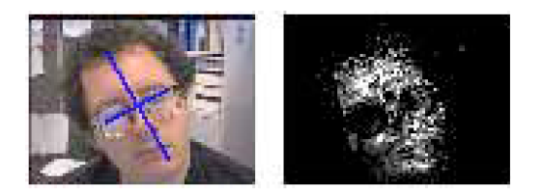

Last time: Example: skin color classification
Now for every pixel in a new image, we can estimate probability that it is generated by skin.
Brighter pixels → higher probability of being skin
Classify pixels based on these probabilities
Kristen Grauman

Slide 6
Today
Window-based generic object detection
basic pipeline
boosting classifiers
face detection as case study

Slide 7
Generic category recognition: basic framework
Build/train object model
Choose a representation
Learn or fit parameters of model / classifier
Generate candidates in new image
Score the candidates

Slide 8
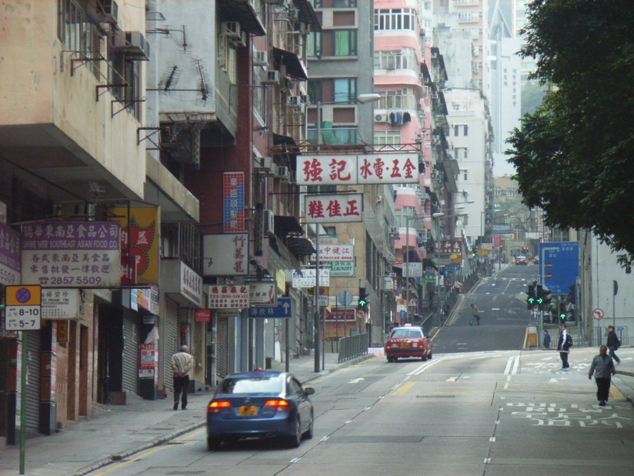

Window-based models Building an object model
Given the representation, train a binary classifier
Car/non-car Classifier
Yes, car.
No, not a car.
Kristen Grauman

Slide 9


Window-based models Generating and scoring candidates
Car/non-car Classifier
Kristen Grauman

Slide 10
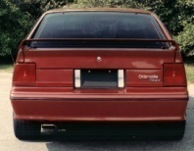
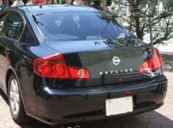

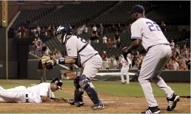
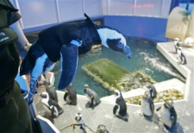
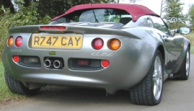
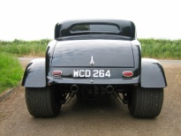

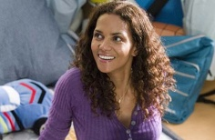
Window-based object detection: recap
Training:
Obtain training data
Define features
Define classifier
Training examples
Car/non-car Classifier
Feature extraction
Kristen Grauman

Slide 11


Window-based object detection: recap
Training:
Obtain training data
Define features
Define classifier
Given new image:
Slide window
Score by classifier
Training examples
Car/non-car Classifier
Feature extraction
Kristen Grauman

Slide 12


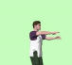
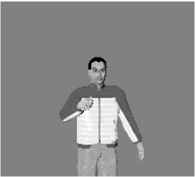

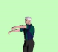
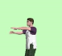

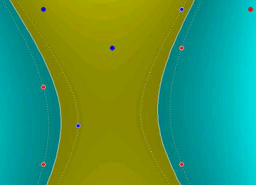
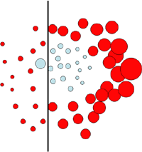
Discriminative classifier construction
Nearest neighbor
Neural networks
10⁶ examples
Shakhnarovich, Viola, Darrell 2003
Berg, Berg, Malik 2005...
LeCun, Bottou, Bengio, Haffner 1998
Rowley, Baluja, Kanade 1998
…
Support Vector Machines
Boosting
Conditional Random Fields
Guyon, Vapnik
Heisele, Serre, Poggio, 2001,…
Viola, Jones 2001, Torralba et al. 2004, Opelt et al. 2006,…
McCallum, Freitag, Pereira 2000; Kumar, Hebert 2003
…
Slide adapted from Antonio Torralba
Notes:
Each has some usual tradeoffs in terms of computational overhead during learning/predictions, amount of free parameters, sensitivity to outlier training points.

Slide 13
Boosting intuition
Weak
Classifier 1
Slide credit: Paul Viola

Slide 14
Boosting illustration
Weights
Increased

Slide 15
Boosting illustration
Weak
Classifier 2

Slide 16
Boosting illustration
Weights
Increased

Slide 17
Boosting illustration
Weak
Classifier 3

Slide 18
Boosting illustration
Final classifier is
a combination of weak classifiers

Slide 19
Boosting: training
Initially, weight each training example equally
In each boosting round:
Find the weak learner that achieves the lowest weighted training error
Raise weights of training examples misclassified by current weak learner
Compute final classifier as linear combination of all weak learners (weight of each learner is directly proportional to its accuracy)
Exact formulas for re-weighting and combining weak learners depend on the particular boosting scheme (e.g., AdaBoost)
Slide credit: Lana Lazebnik

Slide 20
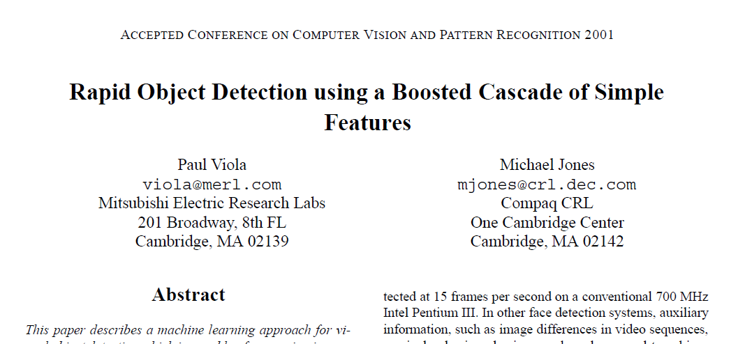
Viola-Jones face detector
Notes:
17000 citations to date.

Slide 21
Viola-Jones face detector
Main idea:
Represent local texture with efficiently computable “rectangular” features within window of interest
Select discriminative features to be weak classifiers
Use boosted combination of them as final classifier
Form a cascade of such classifiers, rejecting clear negatives quickly
Kristen Grauman

Slide 22
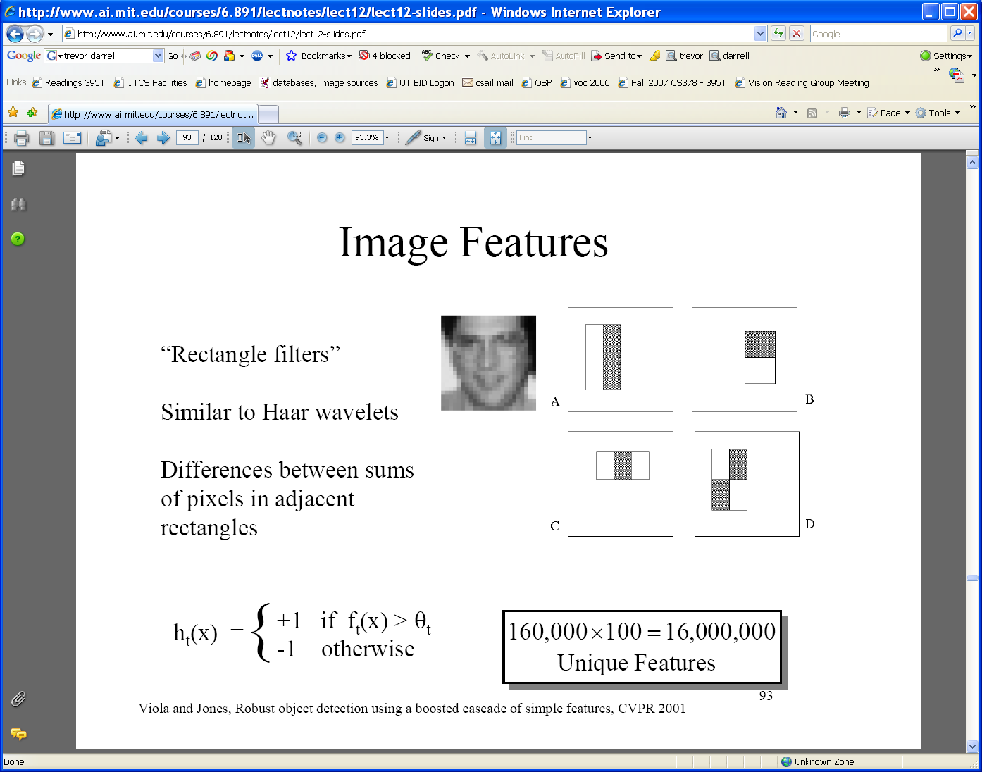
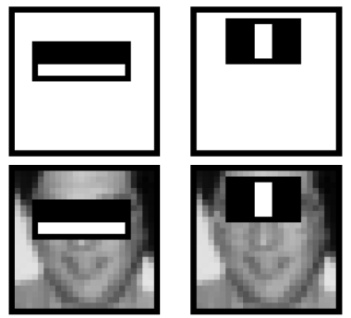
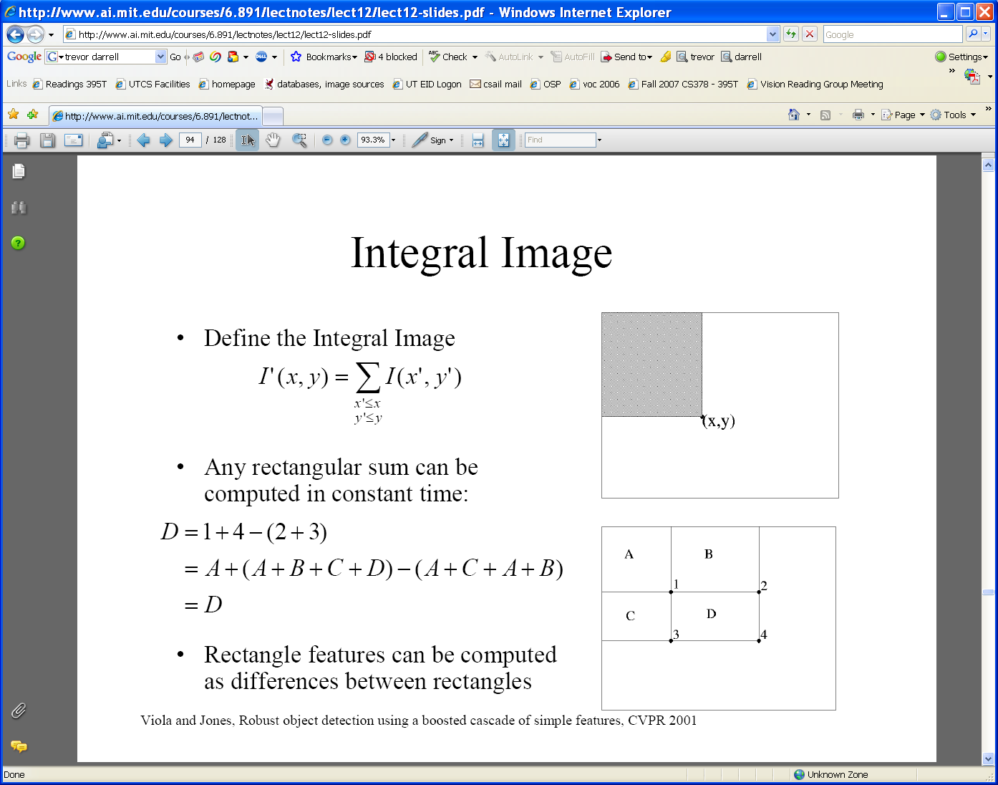
Viola-Jones detector: features
“Rectangular” filters
Feature output is difference between adjacent regions
Value at (x,y) is sum of pixels above and to the left of (x,y)
Efficiently computable with integral image: any sum can be computed in constant time.
Integral image
Kristen Grauman

Slide 23
Computing the integral image
Lana Lazebnik

Slide 24
Computing the integral image
ii(x, y-1)
s(x-1, y)
i(x, y)
Cumulative row sum: s(x, y) = s(x–1, y) + i(x, y)
Integral image: ii(x, y) = ii(x, y−1) + s(x, y)
Lana Lazebnik

Slide 25
Computing sum within a rectangle
Let A,B,C,D be the values of the integral image at the corners of a rectangle
Then the sum of original image values within the rectangle can be computed as:
sum = A – B – C + D
Only 3 additions are required for any size of rectangle!
D
B
C
A
Lana Lazebnik

Slide 26
Viola-Jones detector: features
“Rectangular” filters
Feature output is difference between adjacent regions
Value at (x,y) is sum of pixels above and to the left of (x,y)
Efficiently computable with integral image: any sum can be computed in constant time
Integral image
Kristen Grauman
Notes:
Avoid scaling images → scale features directly for same cost

Slide 27
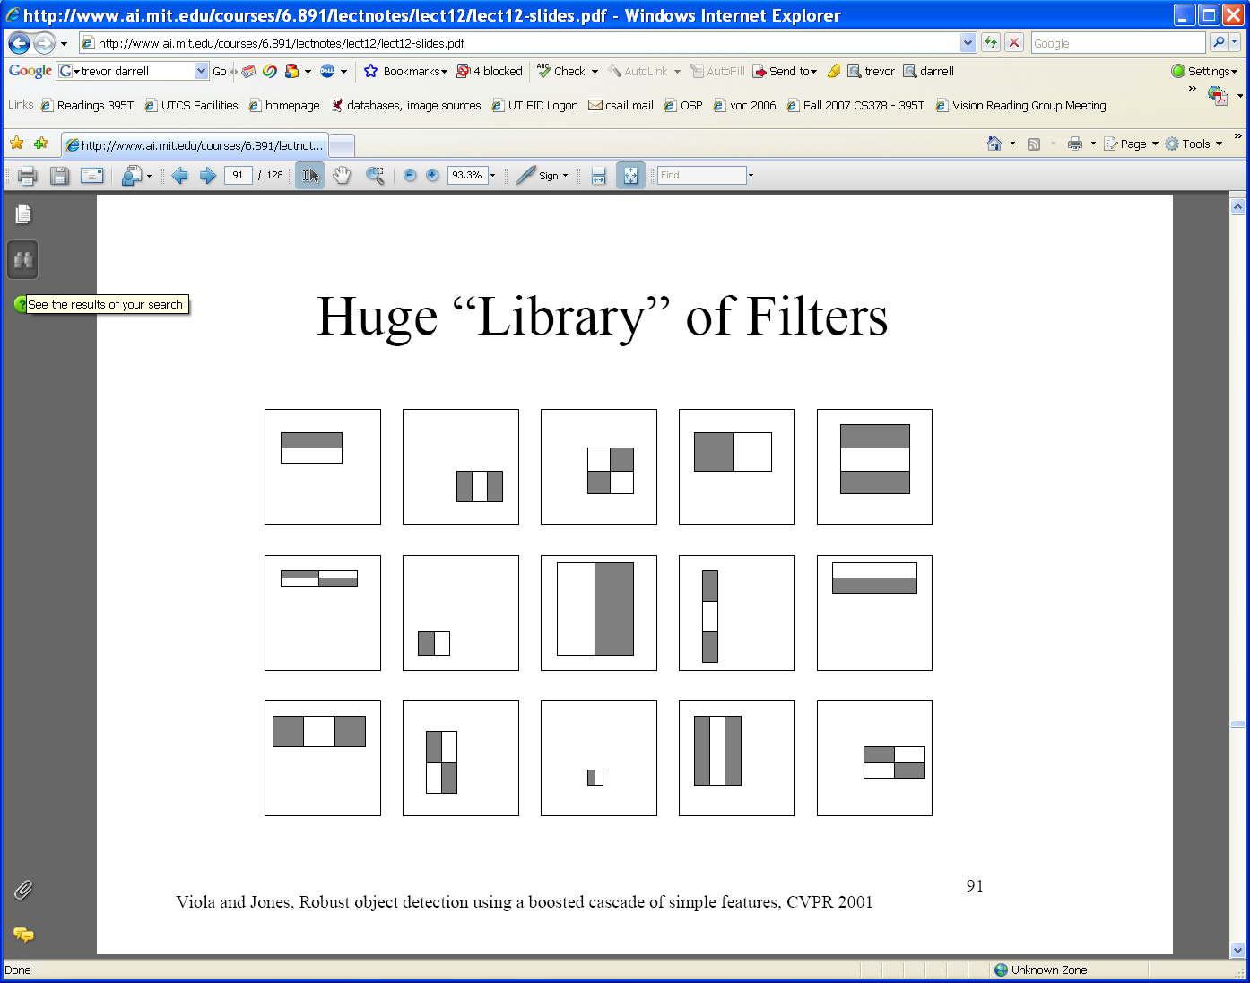
Viola-Jones detector: features
Considering all possible filter parameters: position, scale, and type:
180,000+ possible features associated with each 24 x 24 window
Which subset of these features should we use to determine if a window has a face?
Use AdaBoost both to select the informative features and to form the classifier
Kristen Grauman

Slide 28
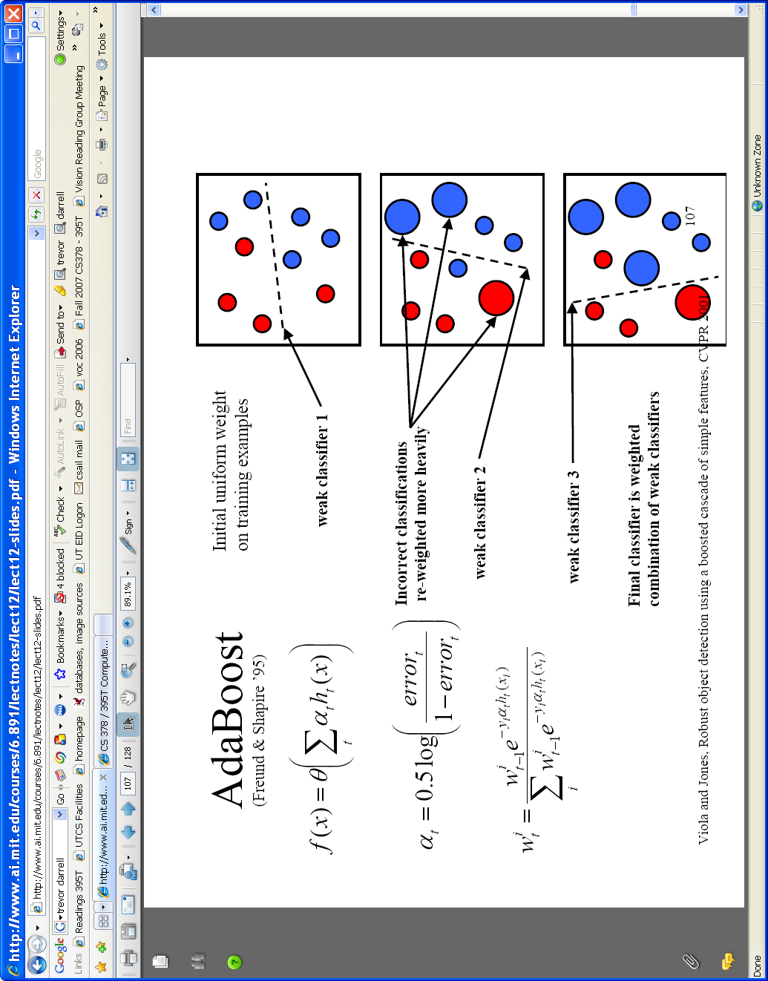
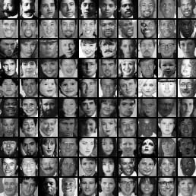
Viola-Jones detector: AdaBoost
Want to select the single rectangle feature and threshold that best separates positive (faces) and negative (non-faces) training examples, in terms of weighted error.
Resulting weak classifier:
For next round, reweight the examples according to errors, choose another filter/threshold combo.
…
Outputs of a possible rectangle feature on faces and non-faces.
Kristen Grauman

Slide 29
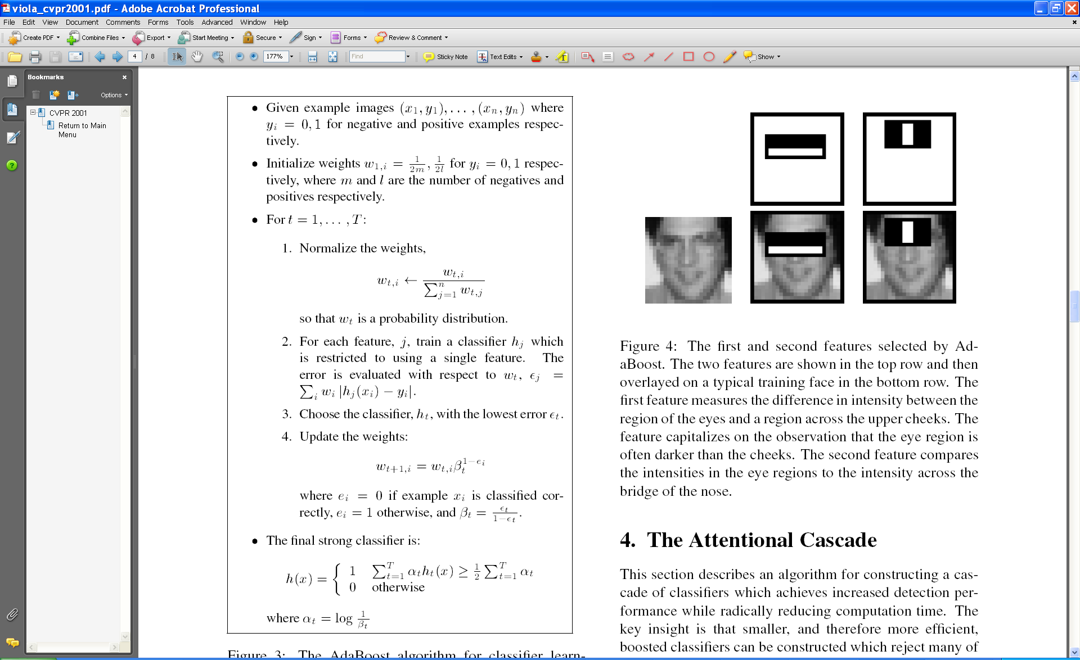
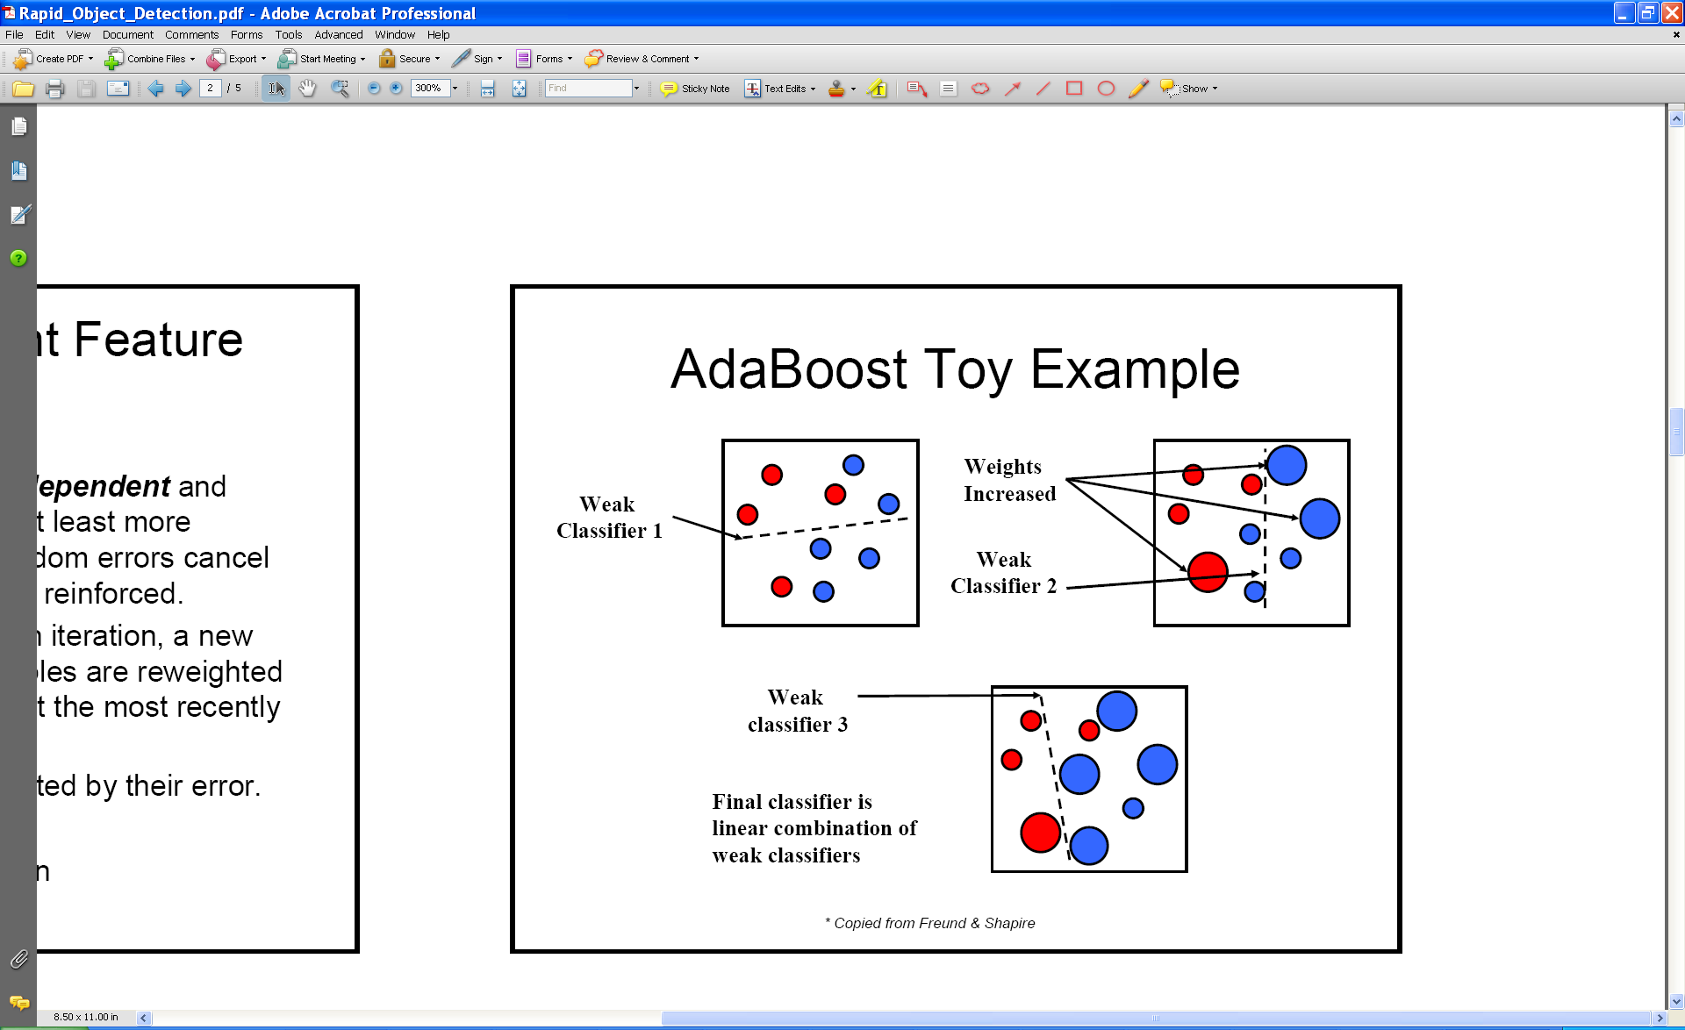
AdaBoost Algorithm
Start with uniform weights on training examples
{x₁,…x_{n}}
For T rounds
Evaluate weighted error for each feature, pick best.
Re-weight the examples:
Incorrectly classified -> more weight
Correctly classified -> less weight
Final classifier is combination of the weak ones, weighted according to error they had.
Freund & Schapire 1995
Notes:
29
Binary, so should be better than chance; i.e., error < 0.5
Alpha becomes bigger as beta decreases (i.e., error decreases)

Slide 30

Viola-Jones Face Detector: Results
First two features selected

Slide 31
Even if the filters are fast to compute, each new image has a lot of possible windows to search.
How to make the detection more efficient?

Slide 32
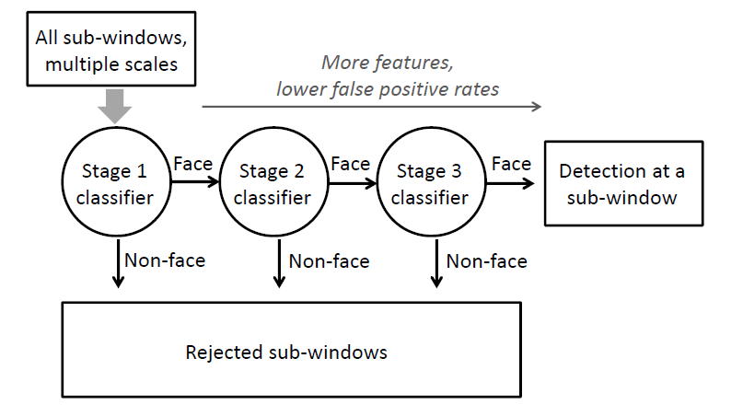
Cascading classifiers for detection
Form a cascade with low false negative (high recall) rates early on
Apply less accurate but faster classifiers first to immediately discard windows that clearly appear to be negative

Slide 33
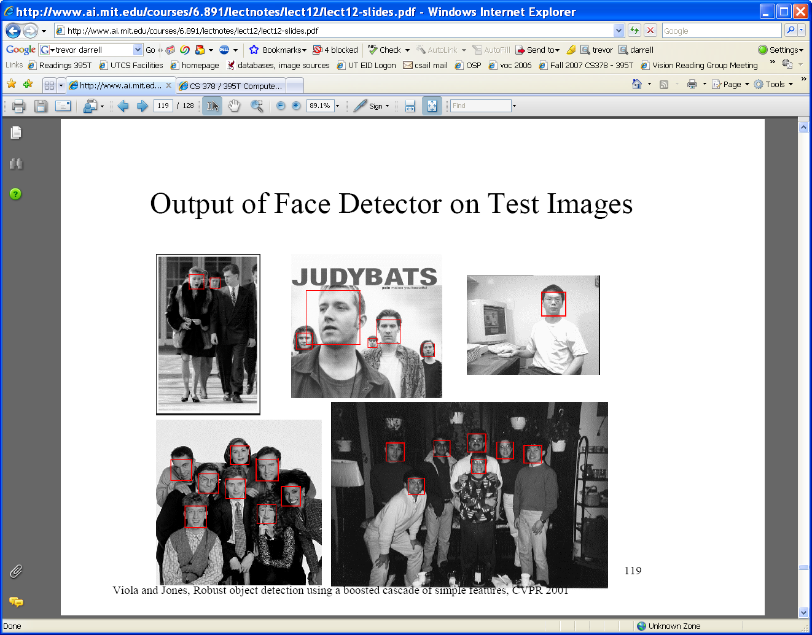
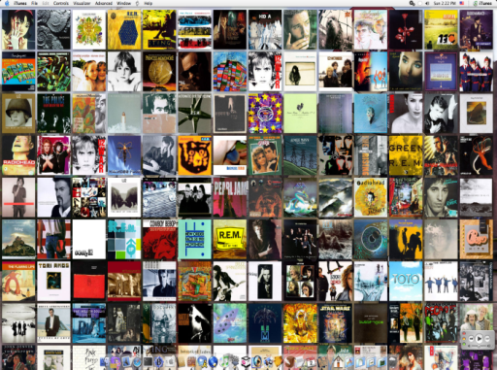




Viola-Jones detector: summary
Train cascade of classifiers with AdaBoost
Apply to each subwindow
Faces
New image
Selected features, thresholds, and weights
Non-faces
Train with 5K positives, 350M negatives
Real-time detector using 38 layer cascade
6061 features in all layers
[Implementation available in OpenCV: http://www.intel.com/technology/computing/opencv/]
Kristen Grauman

Slide 34
Viola-Jones detector: summary
A seminal approach to real-time object detection
Training is slow, but detection is very fast
Key ideas
Integral images for fast feature evaluation
Boosting for feature selection
Attentional cascade of classifiers for fast rejection of non-face windows
P. Viola and M. Jones. Rapid object detection using a boosted cascade of simple features. CVPR 2001.
P. Viola and M. Jones. Robust real-time face detection. IJCV 57(2), 2004.

Slide 35
Viola-Jones Face Detector: Results
Notes:
35

Slide 36
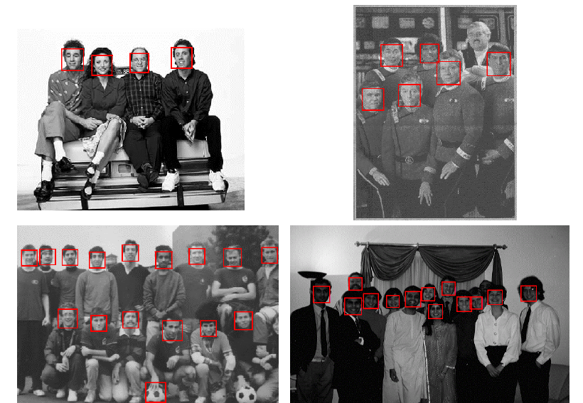
Viola-Jones Face Detector: Results
Notes:
36

Slide 37
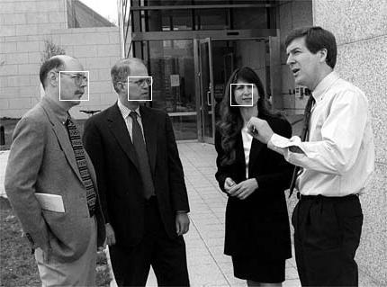
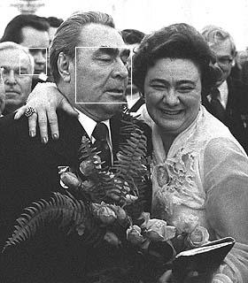
Viola-Jones Face Detector: Results

Slide 38
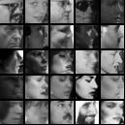
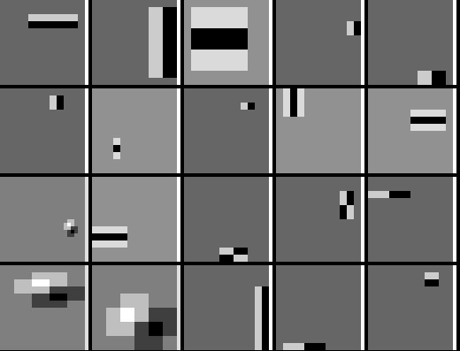
Detecting profile faces?
Can we use the same detector?

Slide 39
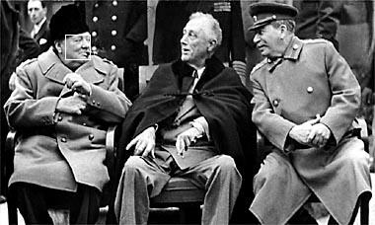
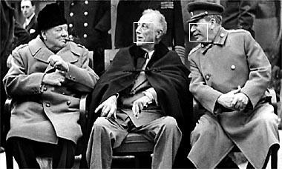
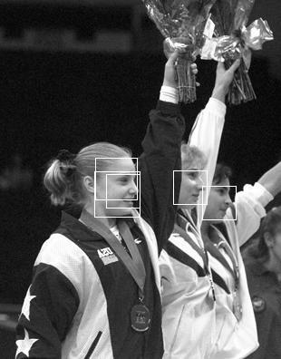
Viola-Jones Face Detector: Results
Paul Viola, ICCV tutorial

Slide 40
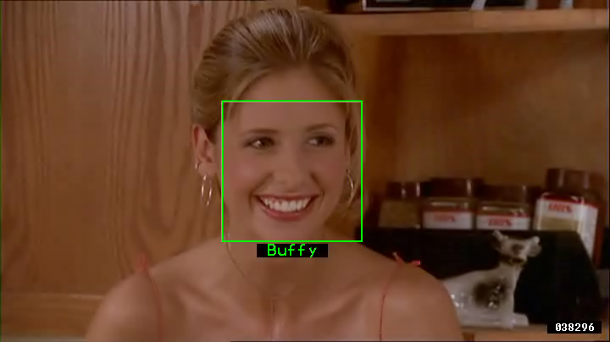
Example using Viola-Jones detector
Frontal faces detected and then tracked, character names inferred with alignment of script and subtitles.
Everingham, M., Sivic, J. and Zisserman, A. "Hello! My name is... Buffy" - Automatic naming of characters in TV video, BMVC 2006. http://www.robots.ox.ac.uk/~vgg/research/nface/index.html
Notes:
40

Slide 41


Slide 42
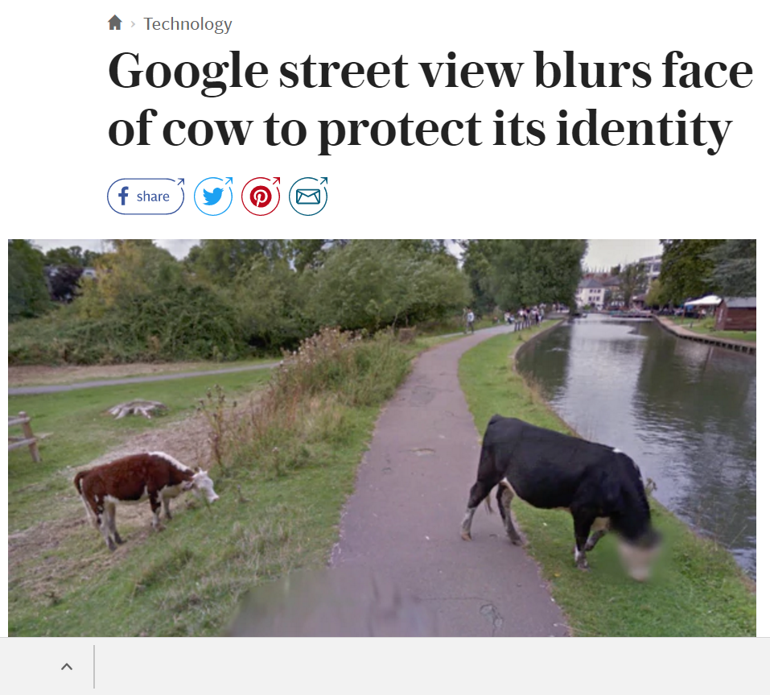
Slide: Kristen Grauman

Slide 43
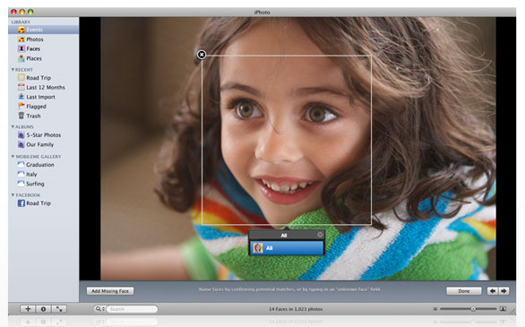
Consumer application: iPhoto 2009
http://www.apple.com/ilife/iphoto/
Slide credit: Lana Lazebnik

Slide 44
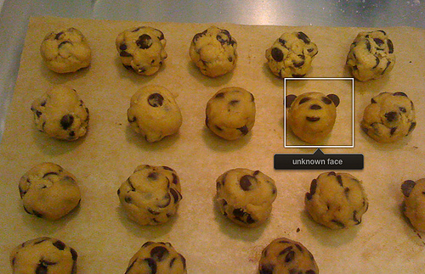
Consumer application: iPhoto 2009
Things iPhoto thinks are faces
Slide credit: Lana Lazebnik

Slide 45
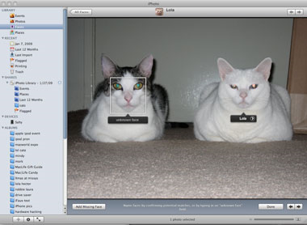
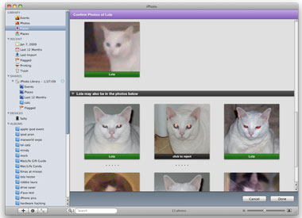
Consumer application: iPhoto 2009
Can be trained to recognize pets!
http://www.maclife.com/article/news/iphotos_faces_recognizes_cats
Slide credit: Lana Lazebnik

Slide 46
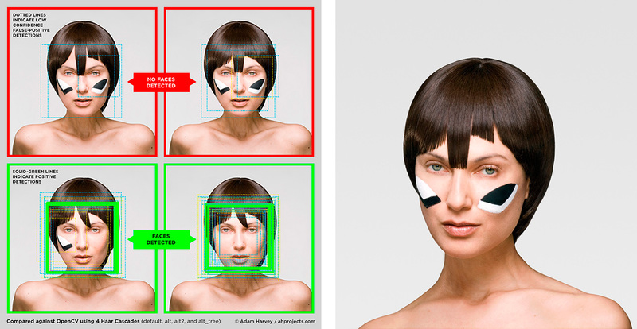
Privacy Gift Shop – CV Dazzle
http://www.wired.com/2015/06/facebook-can-recognize-even-dont-show-face/
Wired, June 15, 2015
Slide: Kristen Grauman
Notes:
CV Dazzle, a project focused on finding fashionable ways to thwart facial-recognition technology.

Slide 47
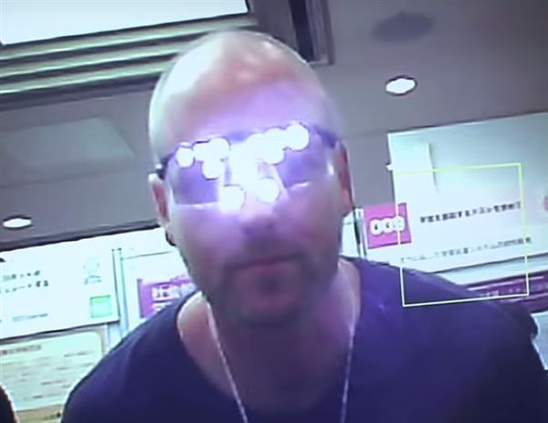
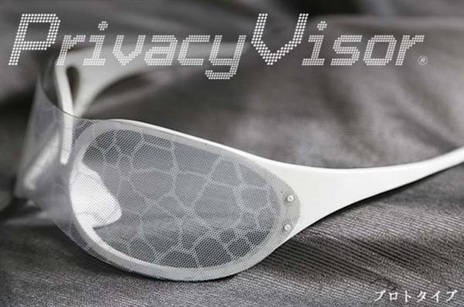
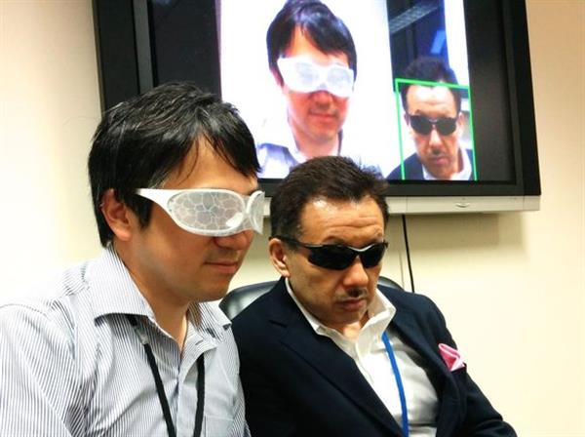
Privacy Visor
http://www.3ders.org/articles/20150812-japan-3d-printed-privacy-visors-will-block-facial-recognition-software.html
Slide: Kristen Grauman
Notes:
Current tests with the glasses have tricked facial recognition software about 90% of the time.
$240

Slide 48
Boosting: pros and cons
Advantages of boosting
Integrates classification with feature selection
Flexibility in the choice of weak learners, boosting scheme
Testing is fast
Easy to implement
Disadvantages
Needs many training examples
Often found not to work as well as an alternative discriminative classifier, support vector machine (SVM)
especially for many-class problems
Slide credit: Lana Lazebnik

Slide 49
What other categories are amenable to window-based representation?

Slide 50
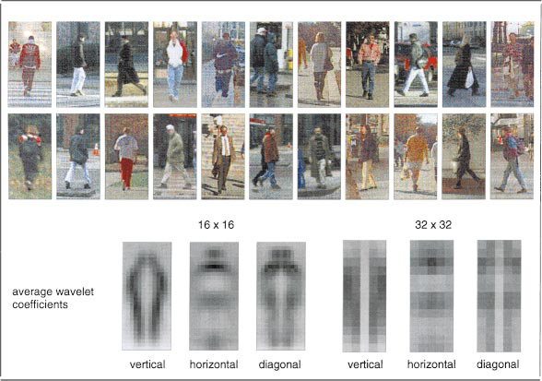
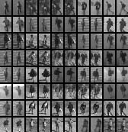

Pedestrian detection
Detecting upright, walking humans also possible using sliding window’s appearance/texture; e.g.,
SVM with Haar wavelets [Papageorgiou & Poggio, IJCV 2000]
Space-time rectangle features [Viola, Jones & Snow, ICCV 2003]
SVM with HoGs [Dalal & Triggs, CVPR 2005]
Kristen Grauman

Slide 51
Window-based detection: strengths
Sliding window detection and global appearance descriptors:
Simple detection protocol to implement
Good feature choices critical
Past successes for certain classes
Kristen Grauman

Slide 52
Window-based detection: Limitations
High computational complexity
For example: 250,000 locations x 30 orientations x 4 scales = 30,000,000 evaluations!
If training binary detectors independently, means cost increases linearly with number of classes
With so many windows, false positive rate better be low
Kristen Grauman

Slide 53


Limitations (continued)
Not all objects are “box” shaped
Kristen Grauman

Slide 54


Limitations (continued)
If considering windows in isolation, context is lost
Sliding window
Detector’s view
Figure credit: Derek Hoiem

Slide 55

Limitations (continued)
In practice, often entails large, cropped training set (expensive)
Requiring good match to a global appearance description can lead to sensitivity to partial occlusions
Image credit: Adam, Rivlin, & Shimshoni
Kristen Grauman

Slide 56
Summary
Basic pipeline for window-based detection
Model/representation/classifier choice
Sliding window and classifier scoring
Boosting classifiers: general idea
Viola-Jones face detector
Exemplar of basic paradigm
Plus key ideas: rectangular features, Adaboost for feature selection, cascade
Pros and cons of window-based detection

Slide 57
Questions?
See you Thursday!

